Slide 1
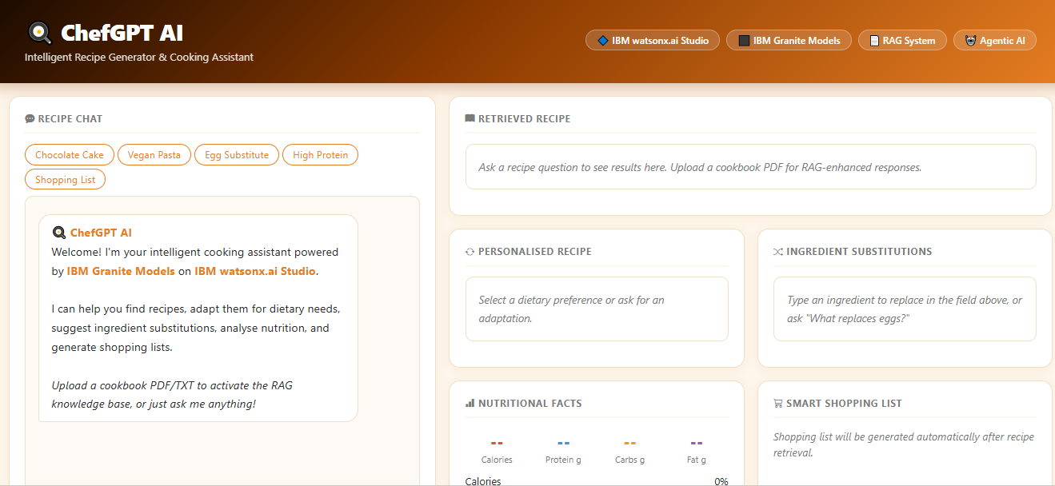
Project Output Screenshot
Please put IBM Bob output screenshots with 2-3 prompts.
You can take 2-3 more slides for each screenshot
·
·
·

Slide 2
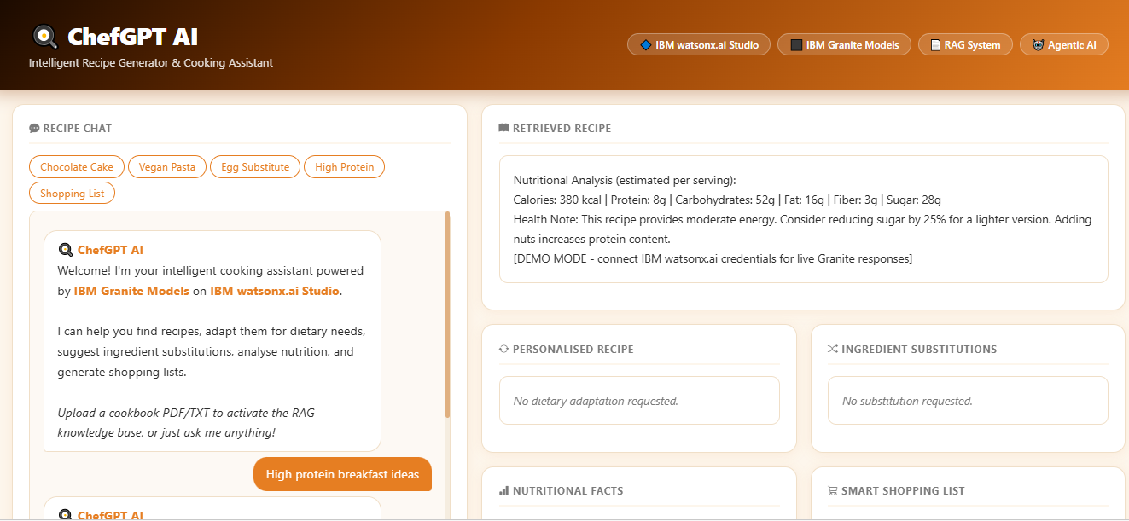
Project Output Screenshot
Please put IBM Bob output screenshots with 2-3 prompts.
You can take 2-3 more slides for each screenshot
·
·
·

Slide 3
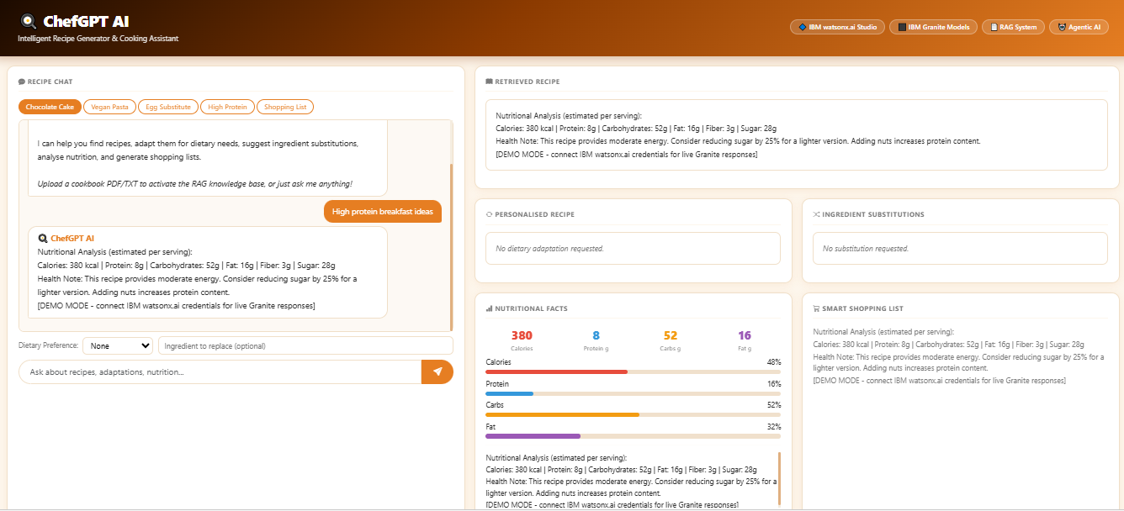

Slide 4
